Slide 1
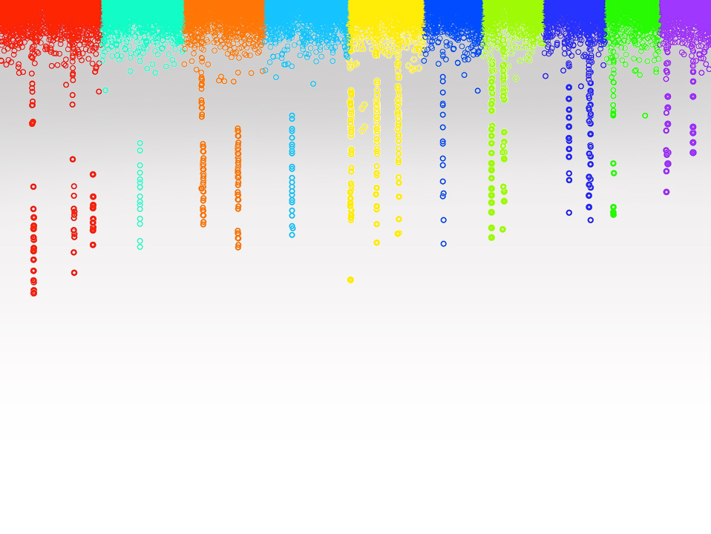

Statistical Genomics
Lecture 2: Programming in R
Zhiwu Zhang
Washington State University

Slide 2
Documents are on Blackboard for previous course
Syllabus
Homework
Exam
Grade distribution
Picture

Slide 3
Current and future needs
"By 2018, the US alone could face a shortage of 1.5 million managers and analysts with the know-how to investigate big data to make effective decisions"
-McKinsey Global Institute, 2014 report

Slide 4
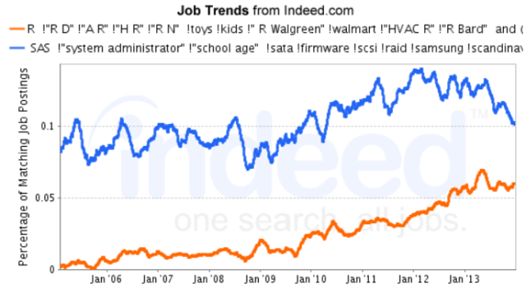
R You Ready for R?
http://www.analyticsvidhya.com/blog/2014/03/sas-vs-vs-python-tool-learn/

Slide 5
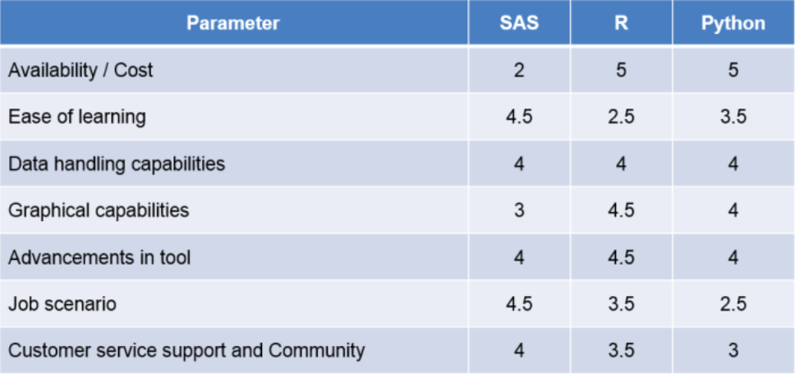
R You Ready for R?
http://www.analyticsvidhya.com/blog/2014/03/sas-vs-vs-python-tool-learn/

Slide 6

Robert Gentleman and Ross Ihaka
Start with S in 1996
Open source
Open packages

Slide 7
IF
if(distribution=="norm")
{addeffect=rnorm(NQTN,0,1)
}else
{addeffect=alpha^(1:NQTN)}

Slide 8
List
return(list(addeffect = addeffect,
y=y,
add = effect,
residual = residual,
QTN.position=QTN.position,
SNPQ=SNPQ))

Slide 9
Loop
myNQTL=c(3,10,20,50,100,200)
for(i in 1:length(myNQTL))
{
myv=validation(n=n,m=m,y=myps$y,X=X,residual=myps$residual,effect=myps$add,QTN.position=myps$QTN.position,addeffect=myps$addeffect,NQTL=myNQTL[i])
print(c(i,myNQTL[i],myv$fit,myv$accuracy))
}

Slide 10
Function
phenoSimu=function(X,h2,alpha,NQTN,distibution,seed){
Define function here
}

Slide 11
Packages
Collection of functions
~8000 on CRAN (Comprehensive R Achieve Network)
install.packages("mypackages")
library("mypackages")

Slide 12
Circular Migration Flow Plots in R
https://gjabel.wordpress.com/2014/03/28/circular-migration-flow-plots-in-r/
library("migest")
demo(cfplot_reg, package = "migest", ask = FALSE)
#You can save the PDF version of the plot (which looks much #better than what comes up in my R graphics device) using
:
dev.copy2pdf(file = "cfplot_reg.pdf", height=10, width=10)
#If you want to view the R script:
file.show(system.file("demo/cfplot_reg.R", package = "migest"))

Slide 13
RG#98: Horizon plot (time series data)
http://rgraphgallery.blogspot.com/2013_05_01_archive.html
require(latticeExtra)
#example data
set.seed(123)
mydat <- ts(matrix(cumsum(rnorm(150 * 10)), ncol = 10))
colnames(mydat) <- paste("TS", letters[1:10], sep = "-")
#simple line plot
xyplot(mydat, scales = list(y = "same"))
# panel with different origin and scale:
horizonplot(mydat, layout = c(1,12), colorkey = TRUE) +
layer(panel.scaleArrow(x = 0.99, digits = 1, col = "grey",
srt = 90, cex = 0.7)) +
layer(lim <- current.panel.limits(),
panel.text(lim$x[1], lim$y[1], round(lim$y[1],1), font = 2,
cex = 0.7, adj = c(-0.5,-0.5), col = "blue"))

Slide 14
RG#100: Trellis map plot with heatmap colors
http://rgraphgallery.blogspot.com/2013_05_01_archive.html
require(maps)
library(mapproj)
worldmap <- map('world', plot = FALSE, fill = FALSE, projection = "azequalarea")
country = worldmap$names
set.seed(1234)
var.2010 = rnorm (length (country), 20, 10)
var.2011 = var.2010*1.1 + rnorm (length (country), 0, 1)
var.2012 = var.2011*0.98 + rnorm (length (country), 0, 4)
var.2013 = var.2011*0.98 + rnorm (length (country), 0, 30)
worldt <- data.frame (country, var.2010, var.2011, var.2012, var.2013)
mapplot(country ~ var.2011, worldt, map = map("world", plot = FALSE, fill = TRUE))

Slide 15
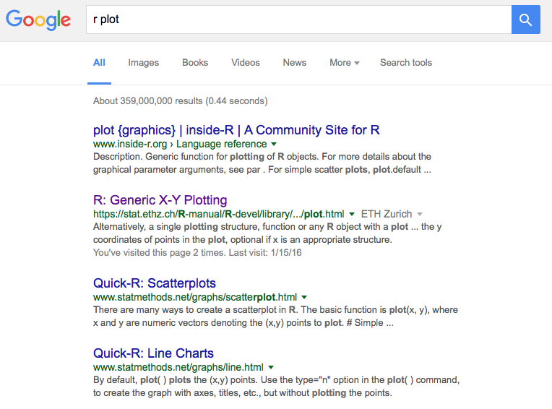

Slide 16
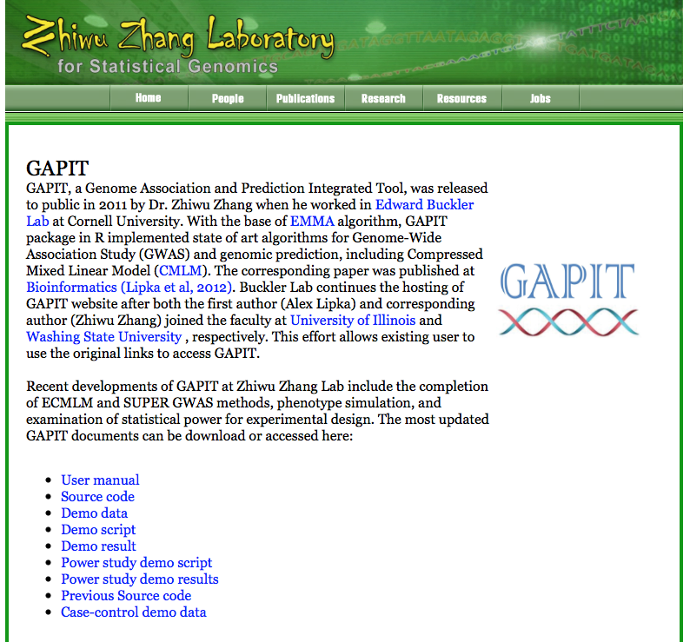

Slide 17
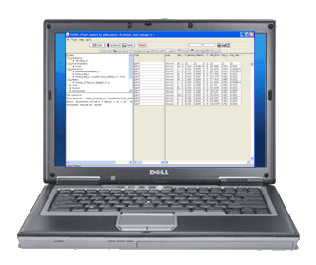
Demonstration

Slide 18
Highlight
File input and output
R objects
numeric vs. character
vector, matrix, and data.frame, list
myF$p
IF and Loop
Apply
Graph
Function

